Slide 1
SELECT statement (Part 2)
CSIT882: Data Management Systems
Notes:
<!-- Neural, Brian, Male, British English. -->
<speak>
<break time="0.5s"/>
<prosody rate="90%">
SELECT statement, part 2.
<break time="0.3s"/>
This presentation explains how to implement the queries with simple conditions.
<break time="0.5s"/>
</prosody>
</speak>
1
Systems Analysis

Slide 2
Outline
Queries with simple conditions
Queries with Boolean expressions
Set algebra queries
Sorting
Queries about the lack of values (NULLs)
Grouping
Grouping with selections
2
Notes:
<!-- Neural, Brian, Male, British English. -->
<speak>
<break time="0.5s"/>
<prosody rate="90%">
Queries with simple conditions.
<break time="0.5s"/>
</prosody>
</speak>
Systems Analysis
2

Slide 3
Queries with simple conditions
Sample database
CREATE TABLE DEPARTMENT(
name VARCHAR(50) NOT NULL,
code CHAR(5) NOT NULL,
total_staff_number DECIMAL(2) NOT NULL,
chair VARCHAR(50) NULL,
budget DECIMAL(9,1) NOT NULL,
CONSTRAINT dept_pkey PRIMARY KEY(name),
CONSTRAINT dept_ckey1 UNIQUE(code),
CONSTRAINT dept_ckey2 UNIQUE(chair),
CONSTRAINT dept_check1 CHECK (total_staff_number BETWEEN 1 AND 50) );
CREATE TABLE COURSE(
cnum CHAR(7) NOT NULL,
title VARCHAR(200) NOT NULL,
credits DECIMAL(2) NOT NULL,
offered_by VARCHAR(50) NULL,
CONSTRAINT course_pkey PRIMARY KEY(cnum),
CONSTRAINT course_check1 CHECK (credits IN (6, 12)),
CONSTRAINT course_fkey1 FOREIGN KEY(offered_by)
REFERENCES DEPARTMENT(name) ON DELETE CASCADE );
3
Notes:
<!-- Neural, Brian, Male, British English. -->
<speak>
<break time="0.5s"/>
<prosody rate="90%">
<break time="0.3s"/>
In this presentation, we use the same sample database, that contains information about the departments and about the courses offered by the departments.
<break time="0.3s"/>
Information about the departments is kept in a relational table: department.
<break time="0.3s"/>
A description of a department consists of a department name, department code, total staff number and budget.
<break time="0.3s"/>
A name of a department uniquelly identifies each department.
<break time="0.3s"/>
A code of a department also uniquelly identifies each department.
<break time="0.3s"/>
Total staff number per department cannot be greater than 50.
<break time="0.3s"/>
A description of a course consists of a course number, title, credits and name of department that offers a course.
<break time="0.3s"/>
A course number is a unique identifier of each course.
<break time="0.3s"/>
The granted credits can be equal to either 6 or 12.
<break time="0.5s"/>
</prosody>
</speak>
Systems Analysis
3

Slide 4
Queries with simple conditions
Find the titles of all 6 credit points courses
SELECT title
FROM COURSE
WHERE credits = 6;
Find the titles of all 6 or 12 credit points courses
SELECT title
FROM COURSE
WHERE credits IN (6, 12);
Find the titles and numbers of all courses that have a word "database" in its title
SELECT title, cnum
FROM COURSE
WHERE UPPER(title) LIKE '%DATABASE%';
4
Notes:
<!-- Neural, Brian, Male, British English. -->
<speak>
<break time="0.5s"/>
<prosody rate="90%">
We start from a simple query, that finds the titles of all 6 credit point courses.
<break time="0.3s"/>
In the first step, we have to find which relational table or which relational tables, must be accessed to retrieve the required information.
<break time="0.3s"/>
From information in CREATE TABLE statements, we find that a relational table: COURSE, contains information about both titles and credits of the courses.
<break time="0.3s"/>
WHERE condition is: credits greater than 6.
<break time="0.3s"/>
A projection on a column: title, returns only the titles of courses.
<break time="0.3s"/>
An objective of the second SELECT statement is to find the titles of all 6 or 12 credit points courses.
<break time="0.3s"/>
It is possible to express a search condition as a disjunction of simple terms: credits = 6 or credits equal to 12.
<break time="0.3s"/>
However, if we would like to express a condition where a value in a column can be one of the values in a given set, then it is easier to do it with set membership operation: in.
<break time="0.3s"/>
A condition: credits in 6 comma 12, means that a value in a column: credits, should be a member of a set 6 comma 12.
<break time="0.3s"/>
All rows, that satisfy a condition: credits in 6 comma 12, will be retrieved from a relational table: COURSE.
<break time="0.3s"/>
Finally in the last SELECT statement, we implement a query that finds the titles and numbers of all courses, that have a word "database" in its title.
<break time="0.3s"/>
When we are not sure if the contents of a database is saved in an uppercase or lowercase format, then we apply a row function: UPPER, to a value in a column: title.
<break time="0.3s"/>
We use an operation: LIKE, to implement a pattern matching search condition, selecting only the rows where a title starts from a word: database, or it includes a word: database, or it ends with a word database.
<break time="0.3s"/>
A percentage sign in a pattern, matches zero or more characters in a string.
<break time="0.3s"/>
It is the same pattern as the star pattern in the regular expressions.
<break time="0.3s"/>
</prosody>
</speak>
Systems Analysis
4

Slide 5
Outline
Queries with simple conditions
Queries with Boolean expressions
Set algebra queries
Sorting
Queries about the lack of values (NULLs)
Grouping
Grouping with selections
5
Notes:
<!-- Neural, Brian, Male, British English. -->
<speak>
<break time="0.5s"/>
<prosody rate="90%">
Queries with Boolean expressions.
<break time="0.5s"/>
</prosody>
</speak>
Systems Analysis
5

Slide 6
Queries with Boolean expressions
Find the titles of all 6 credit points courses offered by a department of Physics
SELECT title
FROM COURSE
WHERE (credits = 6) AND (offered_by ='Physics');
Find the titles of all 6 credit points courses or the titles of all courses offered by a department of Physics
SELECT title
FROM COURSE
WHERE (credits = 6) OR (offered_by ='Physics');
Find the titles of all 6 credit points courses that are not offered by a department of Physics
SELECT title
FROM COURSE
WHERE NOT (offered_by = 'Physics') AND (credits = 6);
6
Notes:
<!-- Neural, Brian, Male, British English. -->
<speak>
<break time="0.5s"/>
<prosody rate="90%">
A Boolean expression consist of: elementary terms, Boolean operators: and, or, not, left and right parenthesis.
<break time="0.3s"/>
In this presentation, we consider only the elementary terms being the comparisons of a column name and a constant, column name and a set of constants or two column names.
<break time="0.3s"/>
In a general case a constant in an elementary term, can be an inline view that evaluates either to a constant or to a set of rows.
<break time="0.3s"/>
In the first example, we implement a query, that finds the titles of all 6 credit points courses offered by a department of Physics
<break time="0.3s"/>
First, we find what relational tables must be accessed to retrieve the required information.
<break time="0.3s"/>
We find, that all columns: credits and offered by, involved in a search condition in WHERE clause, and a column to be returned as an answer are included in a relational table: COURSE.
<break time="0.3s"/>
Such results allow for implementation of SELECT clause as: SELECT title, and FROM clause as : FROM COURSE.
<break time="0.3s"/>
WHERE condition, consists of two elementary terms: credits equals to 6, offered by equals to Physics, joined with a conjunction operator: and.
<break time="0.3s"/>
In the next example, we implement a query: find the titles of all 6 credit points courses or the titles of all courses offered by a department of Physics.
<break time="0.3s"/>
It is almost the same query as in the previous example.
<break time="0.3s"/>
The only difference is a disjunction operator: or, that binds the same elementary terms in WHERE clause.
<break time="0.3s"/>
In the last example, we implement a query that finds the titles of all 6 credit points courses, that are not offered by a department of Physics.
<break time="0.3s"/>
In this case, SELECT and FROM clauses, are the same as in two previous queries.
<break time="0.3s"/>
A negated term: "NOT offered by equals to Physics", means, that the courses we are looking for must not be offered by a department of Physics.
<break time="0.3s"/>
A term: "credits equals to six" expresses the same search condition as before.
<break time="0.3s"/>
An interesting question is, which of the Boolean operators used in WHERE clause, applies first in the evaluation of a search condition ?
<break time="0.3s"/>
Do we compute operator AND, first, and then we negate the results ?
<break time="0.3s"/>
Or do we negate the result of evaluation of a term: "offered by equals to Physics" and then we apply a conjunction operator ?
<break time="0.3s"/>
In S Q L, a negation operator: not, has a higher priority than a conjunction operator: and a disjunction operators : or.
<break time="0.3s"/>
Hence, in our case, the evaluation of a Boolean expression in WHERE clause, starts from the evaluation of an elementary term "offered by equals to Physics" and negation of the result of such evaluation.
<break time="0.3s"/>
Next, a query processor evaluates and elementary term: "credits equals to 6".
<break time="0.3s"/>
And finally, a conjunction operator: and, is evaluated on the results of evaluation of a negation and the second elementary term.
<break time="0.3s"/>
Such procedure is repeated for each row in a relational table: COURSE.
<break time="0.5s"/>
</prosody>
</speak>
Systems Analysis
6

Slide 7
Queries with Boolean expressions
Find the titles of all courses offered by a department of Physics or offered by a department of Mathematics
SELECT title
FROM COURSE
WHERE (offered_by = 'Physics') OR
(offered_by = 'Mathematics');
SELECT title
FROM COURSE
WHERE offered_by IN ('Physics', 'Mathematics');
Find the same titles of all courses offered by a department of Physics and offered by a department of Mathematics
SELECT title
FROM COURSE
WHERE(offered_by = 'Physics') AND
(offered_by = 'Mathematics');
WRONG !!!
7
Notes:
<!-- Neural, Brian, Male, British English. -->
<speak>
<break time="0.5s"/>
<prosody rate="90%">
The first example, shows two different ways of implementation of a query: "find the titles of all courses offered by a department of Physics or offered by a department of Mathematics".
<break time="0.3s"/>
In the first case we create a disjunction of two elementary terms: "offered by equals to Physics" or "offered by equals to "Mathematics".
<break time="0.3s"/>
Evaluation of a disjunction returns true, when either both terms or one of them evaluates to true.
<break time="0.3s"/>
In the second implementation, we use a single term with a set membership operation: IN, and a set constant, that consists of two elements: "Physics" and "Mathematics".
<break time="0.3s"/>
Interpretation of set membership operator is such that a value in a column: offered by, must be one of the values included in a set constant.
<break time="0.3s"/>
In the second example, we try to implement a query that finds the same titles of all courses offered by a department of Physics and offered by a department of Mathematics.
<break time="0.3s"/>
It is probably impossible, that in the reality two departments offer the courses with the same title.
<break time="0.3s"/>
Administration of a university would probably never agree on such situation.
<break time="0.3s"/>
However, for the sake of our example, let us assume, that it is possible to have two or more courses with the same title and offered by the different departments.
<break time="0.3s"/>
Then, the query we are going to implement is almost identical as the first query.
<break time="0.3s"/>
The only difference is, that a disjunction operator: or, is replaced with a conjunction operator: and.
<break time="0.3s"/>
Therefore, someone may naively think, that to implement such query it is enough to replace an operator: and, with an operator: or, as it is written in the slide.
<break time="0.3s"/>
Unfortunately, such solution is completely incorrect.
<break time="0.3s"/>
The solution in the slide is incorrect, because the evaluation of a Boolean expression in WHERE clause, is performed in a "row by row" mode.
<break time="0.3s"/>
If we take a row, and if we try to evaluate a condition: "offered by equals to Physics and offered by equals to Mathematics" then the result of such evaluation is always false, because a value in a row cannot be in the same moment equal to: Physics and equal to: Mathematics.
<break time="0.3s"/>
Therefore, none of the rows will be selected and the answer will always be empty, despite that it is possible, that Physics and Mathematics offer a course with the same title.
<break time="0.3s"/>
Unfortunately, a query like that, cannot be implemented as a simple query with a Boolean expression.
<break time="0.3s"/>
We shall return to this problem in the next video clip.
<break time="0.5s"/>
</prosody>
</speak>
Systems Analysis
7

Slide 8
Outline
Queries with simple conditions
Queries with Boolean expressions
Set algebra queries
Sorting
Queries about the lack of values (NULLs)
Grouping
Grouping with selections
8
Notes:
<!-- Neural, Brian, Male, British English. -->
<speak>
<break time="0.5s"/>
<prosody rate="90%">
Set algebra queries.
<break time="0.5s"/>
</prosody>
</speak>
Systems Analysis
8

Slide 9
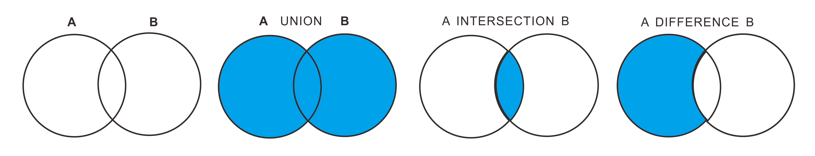
Set algebra queries
Set operations: UNION, INTERSECTION, and DIFFERENCE
A UNION B: all elements in A or in B
A INTERSECTION B: all elements in A and in B
A DIFFERENCE B: all elements in A and not in B
B DIFFERENCE A: all elements in B and not in A
9
Notes:
<!-- Neural, Brian, Male, British English. -->
<speak>
<break time="0.5s"/>
<prosody rate="90%">
We start from a short review of three operation on data sets: UNION, INTERSECTION and DIFFERENCE.
<break time="0.3s"/>
Assume, that we have two sets: A and B.
<break time="0.3s"/>
For example, assume that set each contains the names of colours like: white, blue, red, green and the others.
<break time="0.3s"/>
The sets must not contain the repetitions, for example a set cannot have two names: red and red.
<break time="0.3s"/>
Assume, that a set A contains the colours red and blue and a set B contains the colours red and green.
<break time="0.3s"/>
Assume, that we would like to find, the names of all colours, included in a set A or in a set B.
<break time="0.3s"/>
Such action can be implemented with UNION operation on the sets: A and B.
<break time="0.3s"/>
An operation: A UNION B, copies the elements of the sets: A and B to a result of the operation and it eliminates the duplicated elements.
<break time="0.3s"/>
Then, the result of: A UNION B, is a set that contains the colours: red, green and blue.
<break time="0.3s"/>
Again note, that a colour red is NOT repeated twice.
<break time="0.3s"/>
An operation of INTERSECTION finds the same elements in both arguments of the operation.
<break time="0.3s"/>
For example, A INTERSECTION B, returns a set, that consists of a single element: red, because a red colour is member of both sets A and B.
<break time="0.3s"/>
An operation of DIFFERENCE finds all elements, that are included in the first argument and, that are not included in the second argument.
<break time="0.3s"/>
For example A DIFFERENCE B, returns a set that consists of one element: blue.
<break time="0.3s"/>
This is because, blue is the only element, that is included in A and, that is not included in B.
<break time="0.3s"/>
The diagrams, that visualize the outcomes of the set operations are presented in the slide.
<break time="0.3s"/>
Such diagrams are commonly called Venn diagrams.
<break time="0.3s"/>
Venn diagrams have been named after the English mathematician John Venn, who for the first time used the diagrams illustrating the outcomes of set operations, in his research paper published in 1880.
<break time="0.5s"/>
</prosody>
</speak>
Systems Analysis
9

Slide 10
Set algebra queries
UNION operation
Find the credit points of courses offered by a Department of Physics or a Department of Mathematics and do not list duplicated rows
SELECT DISTINCT credits
FROM COURSE
WHERE (offered_by = 'Physics') OR
(offered_by = 'Mathematics');
SELECT credits
FROM COURSE
WHERE offered_by = 'Physics’
UNION
SELECT credits
FROM COURSE
WHERE offered_by = 'Mathematics';
UNION operation automatically eliminates duplicated rows !!!
10
Notes:
<!-- Neural, Brian, Male, British English. -->
<speak>
<break time="0.5s"/>
<prosody rate="90%">
S Q L implements the set operations, because such operations provide a very convenient way of expressing queries, that act on the sets of rows in the relational tables.
<break time="0.3s"/>
For example, an earlier implemented query: "find the credit points of courses offered by a Department of Physics or a Department of Mathematics and do not list duplicated rows", can be implemented as a simple query with a Boolean expression and a DISTINCT keyword in the SELECT clause.
<break time="0.3s"/>
The same query, can be implemented as a union of the results returned by two SELECT statements, that separately find the credits of courses offered by Physics and the credits of courses offered by Mathematics, get the results together and eliminate the duplicates.
<break time="0.3s"/>
A sample implementation of SELECT statement, with a UNION operation, is given at the bottom of the present slide.
<break time="0.3s"/>
Please note, that a UNION operation, automatically removes the duplicated rows from the final result.
<break time="0.5s"/>
</prosody>
</speak>
Systems Analysis
10

Slide 11
Set algebra queries
UNION ALL operation
Find the credit points of courses offered by a Department of Physics or a Department of Mathematics
SELECT credits
FROM COURSE
WHERE (offered_by = 'Physics') OR
(offered_by = 'Mathematics');
SELECT credits
FROM COURSE
WHERE offered_by = 'Physics’
UNION ALL
SELECT credits
FROM COURSE
WHERE offered_by = 'Mathematics’;
UNION ALL operation does NOT eliminate duplicated rows !!!
11
Notes:
<!-- Neural, Brian, Male, British English. -->
<speak>
<break time="0.5s"/>
<prosody rate="90%">
Now, assume that we do not want to eliminate the duplicates from the result of UNION operation.
<break time="0.3s"/>
We implement the same query: "find the credit points of the courses offered by a department of Physics or a department of Mathematics", except, that we do not remove the duplicates.
<break time="0.3s"/>
In such a case, we must use an operation: UNION ALL.
<break time="0.3s"/>
An operation: UNION ALL, is the same as an operation UNION, without elimination of duplicates.
<break time="0.3s"/>
It also means, that the result of an operation: UNION ALL, is no longer a set of rows but a multiset of rows.
<break time="0.5s"/>
</prosody>
</speak>
Systems Analysis
11

Slide 12
Set algebra queries
What about other set operations like intersection (INTERSECT) and difference (MINUS) ?
MySQL does not implement INTERSECT and MINUS set operations :( !!!
So, how do we implement in MySQL queries with INTERSECT and MINUS set operations ?
Find the titles of course offered by the departments of Physics and Mathematics.
SELECT title
FROM (SELECT title FROM COURSE
WHERE offered_by = 'Physics’) P
JOIN
(SELECT title FROM COURSE
WHERE offered_by = 'Mathematics’) M
ON P.title = M.title;
12
Notes:
<!-- Neural, Brian, Male, British English. -->
<speak>
<break time="0.5s"/>
<prosody rate="90%">
What about the other set operations, like the intersection (INTERSECT) and the difference (MINUS) ?
<break time="0.3s"/>
Some larger database systems implement all set operations: UNION, UNION ALL, INTERSECT and MINUS.
<break time="0.3s"/>
My S Q L implements only the operations: UNION and UNION ALL.
<break time="0.3s"/>
What about the other operations on sets ?
<break time="0.3s"/>
The INTERSECT operation can be implemented as the JOIN operation or as a nested query.
<break time="0.3s"/>
The MINUS operation can be implemented as a nested query or as the OUTER JOIN operation.
<break time="0.3s"/>
The operations: JOIN, OUTER JOIN, and nested queries will be presented in the future.
<break time="0.3s"/>
Now, we return to our old problem: how to implement a query, that "finds the titles of courses offered by the departments of Physics and Mathematics".
<break time="0.3s"/>
We have already tried to implement such query as a simple SELECT statement, with a Boolean expression as a conjunction of two elementary terms.
<break time="0.3s"/>
Such solution appeared to be incorrect.
<break time="0.3s"/>
If we would like to find the titles of courses offered by the departments of Physics and Mathematics, then we can separately find a set of titles of courses offered by Physics and a set of titles of courses offered by Mathematics and next, we can compute the intersection of two sets.
<break time="0.3s"/>
It means, that we can implement two simple SELECT statements, one finding the titles of courses offered by a department of Physics and the other finding the courses offered by a department of Mathematics and use operation: INTERSECT, to find the common titles of the courses.
<break time="0.3s"/>
In a database systems that implement the set operation INTERSECT, it is a correct solution.
<break time="0.3s"/>
Unfortunately, My S Q L does not implement the operation INTERSECT, and instead we have to use an operation JOIN of two inline views.
<break time="0.3s"/>
Note, that join of two relational tables that have identical schemas is equivalent to the operation INTERSECT.
<break time="0.5s"/>
</prosody>
</speak>
Systems Analysis
12

Slide 13
Set algebra queries
What about other set operations like intersection (INTERSECT) and difference (MINUS) ?
MySQL does not implement INTERSECT and MINUS set operations :( !!!
So, how do we implement in MySQL queries with INTERSECT and MINUS set operations ?
Find the titles of course offered by a Department of Physics and NOT offered by a Department of Mathematics
SELECT title
FROM COURSE
WHERE offered_by = 'Physics' AND
title NOT IN (SELECT title
FROM COURSE
WHERE offered_by = 'Mathematics');
13
Notes:
<!-- Neural, Brian, Male, British English. -->
<speak>
<break time="0.5s"/>
<prosody rate="90%">
What about an operation of set difference: MINUS ?
<break time="0.3s"/>
My S Q L also does not implement an operation MINUS.
<break time="0.3s"/>
For example a query: "find the titles of course offered by a department of Physics and NOT offered by department of Mathematics",
can be implemented as a nested query.
<break time="0.3s"/>
A nested SELECT statement, finds the titles of courses offered by a department of Mathematics first.
<break time="0.3s"/>
Then, it finds the titles of courses offered by a department of Physics and such that these titles are not included in the results of the first SELECT statement.
<break time="0.3s"/>
It means, that the title of courses must not be offered by a department of Mathematics.
<break time="0.3s"/>
Implementation of the query as a nested SELECT statement, is given at the bottom of the present slide.
<break time="0.5s"/>
</prosody>
</speak>
Systems Analysis
13

Slide 14
Outline
Queries with simple conditions
Queries with Boolean expressions
Set algebra queries
Sorting
Queries about the lack of values (NULLs)
Grouping
Grouping with selections
14
Notes:
<!-- Neural, Brian, Male, British English. --><speak><break time="0.5s"/><prosody rate="90%">Sorting.<break time="0.5s"/></prosody></speak>
Systems Analysis
14

Slide 15
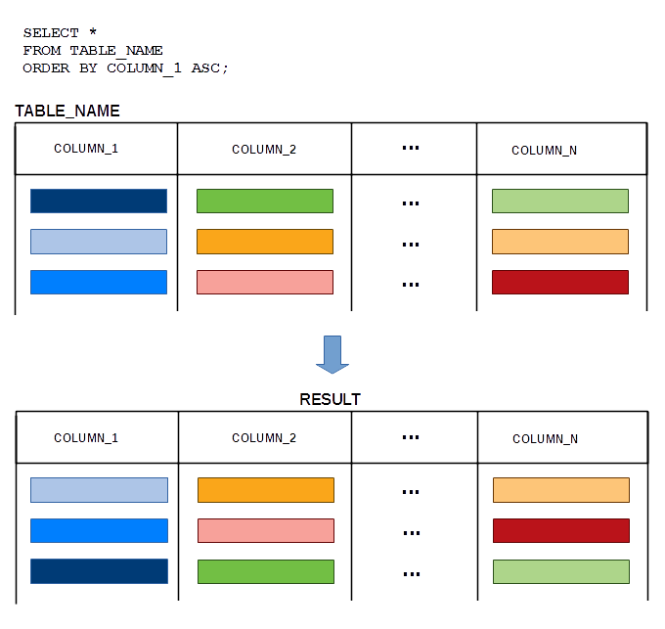
Sorting
Sorting re-orders the rows in the results of a query
15
Notes:
<!-- Neural, Brian, Male, British English. --><speak><break time="0.5s"/><prosody rate="90%"><break time="0.3s"/>Very frequently, we expect the results from the query processing to be returned, in a given order.<break time="0.3s"/>ORDER BY clause of SELECT statement, determines which columns are used, to sort the results of query processing and what order is applied.<break time="0.3s"/>For example, SELECT statement given the present slide sorts the rows, selected from a relational table: TABLE NAME, in the ascending order of the values included in a column: COLUMN 1.<break time="0.3s"/>Ascending order is indicated by a keyword A S C following a name of a column: COLUMN 1.<break time="0.3s"/>All rows returned by the processing of SELECT statement, are sorted in the ascending order of the "darkness" of the blue values included in a column: COLUMN 1.<break time="0.5s"/></prosody></speak>
Systems Analysis
15

Slide 16
Sorting
Find the numbers and titles of all 6 credit points courses sorted in the ascending order of titles
SELECT cnum, title
FROM COURSE
WHERE credits = 6
ORDER BY title ASC;
SELECT cnum, title
FROM COURSE
WHERE credits = 6
ORDER BY 2 ASC;
16
Notes:
<!-- Neural, Brian, Male, British English. --><speak><break time="0.5s"/><prosody rate="90%">Assume, that we would like to find the numbers and titles of courses, worth 6 credit points and we would like to sort the results in the ascending lexicographical order of the titles.<break time="0.3s"/>To implement sorting, ORDER BY clause following WHERE clause, lists a column: title, followed by a keyword A S C, that means sorting in the ascending order.<break time="0.3s"/>In the second SELECT statement in the present slide, ORDER BY clause, determines a column to be used for sorting by a reference to a column number in SELECT clause.<break time="0.3s"/>A column: title, is listed at the position two in SELECT clause.<break time="0.3s"/>This is why a clause ORDER BY 2 A S C, in the second SELECT statement, means sorting of the results in the same order as in the first SELECT statement.<break time="0.5s"/></prosody></speak>
Systems Analysis
16

Slide 17
Sorting
Find the numbers and titles of all 6 credit point courses sorted in a descending order of titles
SELECT cnum, title
FROM COURSE
WHERE credits = 6
ORDER BY title DESC;
SELECT cnum, title
FROM COURSE
WHERE credits = 6
ORDER BY 2 DESC;
17
Notes:
<!-- Neural, Brian, Male, British English. --><speak><break time="0.5s"/><prosody rate="90%">Now assume, that we would like to sort the results of the same SELECT statement from the previous slide, in the descending order of the values in a column: title.<break time="0.3s"/>To implement sorting, ORDER BY clause following WHERE clause, lists a column: title, followed by a keyword D E S C, that means sorting in the descending order.<break time="0.3s"/>In the second SELECT statement, ORDER BY clause, determines a column to be used for sorting by a reference to a column number in SELECT clause.<break time="0.3s"/>A column: title, is listed at the position two in SELECT clause.<break time="0.3s"/>This is why a clause ORDER BY 2 D E S C in the second SELECT statement, means sorting of the results in the same order as in the first SELECT statement.<break time="0.5s"/></prosody></speak>
Systems Analysis
17

Slide 18
Sorting
Find the numbers, titles, and credits of all courses sorted in an ascending order of credits and for all courses with the same credits sorted in descending order by titles
SELECT cnum, title, credits
FROM COURSE
ORDER BY credits ASC, title DESC;
SELECT cnum, title, credits
FROM COURSE
ORDER BY 3 ASC, 2 DESC;
18
Notes:
<!-- Neural, Brian, Male, British English. --><speak><break time="0.5s"/><prosody rate="90%">Sometimes, a single sorting column, is not sufficient, to sort the results from SELECT statement in the appropriate way.<break time="0.3s"/>For example, when a column used for sorting, has a small number of distinct values, then we may get a small number of pretty large groups of rows.<break time="0.3s"/>Then, we need to sort each group of rows again.<break time="0.3s"/>For example, assume, that we would like to find the numbers, titles, and credits of all courses sorted in an ascending order of credits and for all courses with the same number of credits, sorted in the descending order by titles. <break time="0.3s"/>To sort the results of SELECT statement, first by credits and next in the groups of courses with the same credits, by course title we add ORDER BY clause with a list of columns: credits and title.<break time="0.3s"/>The names of columns on ORDER BY list, are followed by the sorting orders: A S C for ascending and D E S C for descending order.<break time="0.3s"/>It is possible to use the numbers of columns on SELECT clause list, instead of the names of columns like in the second DELETE statement in the present slide.<break time="0.5s"/></prosody></speak>
Systems Analysis
18

Slide 19
Outline
Queries with simple conditions
Queries with Boolean expressions
Set algebra queries
Sorting
Queries about the lack of values (NULLs)
Grouping
Grouping with selections
19
Notes:
<!-- Neural, Brian, Male, British English. --><speak><break time="0.5s"/><prosody rate="90%">Queries about the lack of values (NULLs)<break time="0.3s"/></prosody></speak>
Systems Analysis
19

Slide 20
Queries about lack of values (NULLs)
Find the titles of all courses which are not offered now
SELECT title
FROM COURSE
WHERE offered_by IS NULL;
SELECT title
FROM COURSE
WHERE offered_by = NULL;
WRONG !!! The lack of value cannot be compared with a value
20
Notes:
<!-- Neural, Brian, Male, British English. --><speak><break time="0.5s"/><prosody rate="90%">When a relational table is created with CREATE TABLE statement, then it is possible to say, that the values in a column are optional and such fact is represented by a symbol: NULL.<break time="0.3s"/>It means, that such column may have no values in some of its slots.<break time="0.3s"/>In an extreme case the entire column can be empty.<break time="0.3s"/>An empty slot in a column, is represented by a symbol: NULL.<break time="0.3s"/>An interesting question is, how SELECT statements refer to the empty slots in the relational tables ?<break time="0.3s"/>For example, consider an implementation of a query: "find the titles of all courses that are not offered now".<break time="0.3s"/>If a course is not offered, then a row that contains information about such course has an empty slot in a column: offered by.<break time="0.3s"/>An empty slot in a relational table is represented by a symbol: NULL.<break time="0.3s"/>To express a condition, that compares a slot in a relational table with an empty values represented by: NULL, we use an operator: IS.<break time="0.3s"/>The first SELECT statement, in the present slide, correctly compares the slots in a column: offered by, with an empty space represented by a symbol: NULL.<break time="0.3s"/>The second SELECT statement, uses an equal sign, to compare the slots in a column: offered by, with an empty space.<break time="0.3s"/>Such comparison is incorrect, because an equal sign cannot be used to compare the values with nothing, represented by a symbol NULL.<break time="0.5s"/></prosody></speak>
Systems Analysis
20

Slide 21
Queries about lack of values (NULLs)
Find the titles of all courses offered now
SELECT title
FROM COURSE
WHERE offered_by IS NOT NULL;
SELECT title
FROM COURSE
WHERE offered_by <> NULL;
WRONG !!! The lack of value cannot be compared with a value
21
Notes:
<!-- Neural, Brian, Male, British English. --><speak><break time="0.5s"/><prosody rate="90%">What if in the opposite case, we would like to find the titles of all courses that are offered now ?<break time="0.3s"/>Then, instead of a comparison: IS, we have to use a comparison: IS NOT, or we have to negate WHERE condition, used in the previous example.<break time="0.3s"/>A comparison of the values in a column: offered by, with nothing, represented by a symbol: NULL, using a symbol: not equal is incorrect because a not equal comparison cannot compare a value with nothing.<break time="0.3s"/>Therefore, the second SELECT statement in the present slide is incorrect.<break time="0.5s"/></prosody></speak>
Systems Analysis
21

Slide 22
Outline
Queries with simple conditions
Queries with Boolean expressions
Set algebra queries
Sorting
Queries about the lack of values (NULLs)
Grouping
Grouping with selections
22
Notes:
<!-- Neural, Brian, Male, British English. --><speak><break time="0.5s"/><prosody rate="90%">Grouping.<break time="0.5s"/></prosody></speak>
Systems Analysis
22

Slide 23
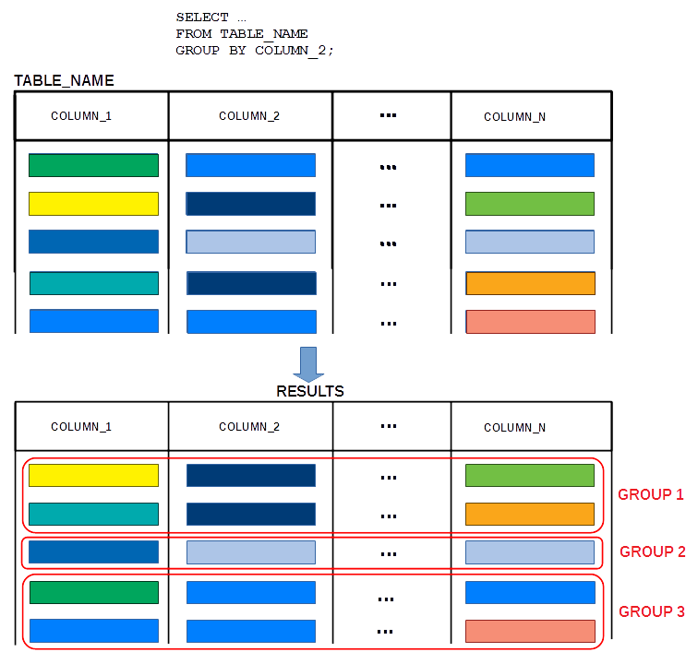
Grouping
Grouping groups the rows before application of aggregation function
23
Notes:
<!-- Neural, Brian, Male, British English. --><speak><break time="0.5s"/><prosody rate="90%">Now, we consider a relational table that contains the rows with different colours.<break time="0.3s"/>Assume, that we would like to find the total number of rows that have the same colour in a COLUMN 2.<break time="0.3s"/>We can see one row in light blue color in a COLUMN 2, two rows in blue color and two rows in dark blue colour in a COLUMN 2.<break time="0.3s"/>To get such results, we created the groups of rows that have the same colour in a COLUMN 2 and we counted total number of rows in each group.<break time="0.3s"/>This is what GROUP BY clause does when it is applied in SELECT statement.<break time="0.3s"/>GROUP BY clause is always located after WHERE clause in SELECT statement.<break time="0.3s"/>A list of column names following a GROUP BY keyword, determines the values in the rows, that are used for grouping.<break time="0.3s"/>In the other words, a GROUP BY clause, groups the rows with the identical values in the columns listed in GROUP BY clause.<break time="0.3s"/>An example of grouping visualized in the present slide creates three groups: GROUP 1, with a dark blue colour, GROUP 2: with light blue colour and GROUP 3 with blue colour.<break time="0.3s"/>If we use a GROUP BY clause, then a SELECT clause, must list only the columns included in a GROUP BY clause.<break time="0.3s"/>It is also possible to append to a SELECT clause, the group functions processing the values in the other columns of a relational table.<break time="0.3s"/>If in our example, grouping is performed over the values in a COLUMN 2, then it is possible to list name: COLUMN 2, in a SELECT clause and no other column.<break time="0.3s"/>Then, the SELECT statement returns the distinct values included in a COLUMN 2.<break time="0.3s"/>Of course, it is not the best way to implement selection of the distinct value from a column.<break time="0.3s"/>SELECT clause with: DISTINCT COLUMN 2 is a much better solution.<break time="0.3s"/>So, why do we need grouping ?<break time="0.3s"/>Grouping of the rows in a relational table is an intermediate stage, that prepares a relational table to the application of the group functions, also called "aggregation functions". <break time="0.3s"/>The application of the group functions to the results of grouping is explained in the next slide.<break time="0.5s"/></prosody></speak>
Systems Analysis
23

Slide 24
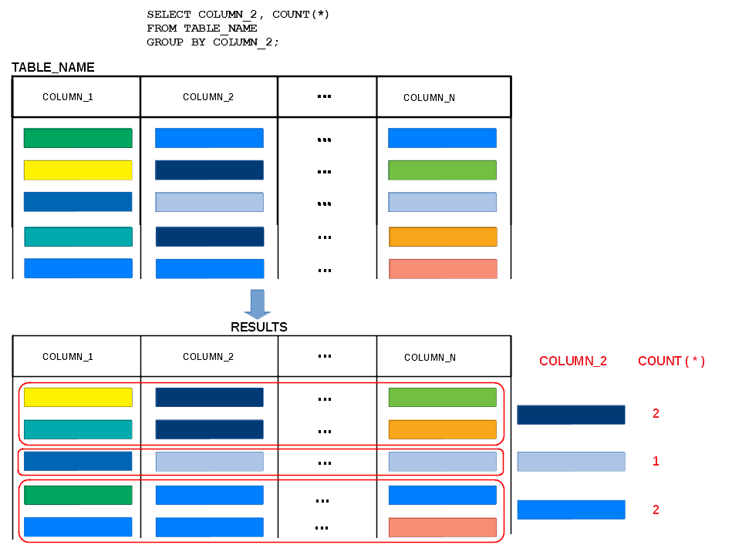
Grouping
Next, aggregation function is applied to each group and the results are associated with the values taken from a column used for grouping
24
Notes:
<!-- Neural, Brian, Male, British English. --><speak><break time="0.5s"/><prosody rate="90%">We return to our original problem from the previous slide.<break time="0.3s"/>We would to find the total number of rows that that have the same colour in a COLUMN 2.<break time="0.3s"/>If we apply grouping with a GROUP BY clause, and we use a COLUMN 2 in a SELECT clause, then to count the total number of rows in each group we append: COUNT star group function, to a list of columns in a SELECT clause.<break time="0.3s"/>Then, a group function: COUNT star is applied to each group in an intermediate relational table, obtained from the processing of a GROUP BY clause.<break time="0.3s"/>When a COUNT function is applied to a dark blue group, it returns 2, counting of the rows applied to a light blue group returns one, and counting of the rows in a blue group returns 2.<break time="0.3s"/>We count the rows because an argument of COUNT function is a star.<break time="0.3s"/>It is possible to count the individual values in a given column.<break time="0.3s"/>We shall return to such aggregations later.<break time="0.3s"/>When COUNT function is applied to each group, the results of counting are associated with the values taken from a COLUMN 2 used for grouping.<break time="0.3s"/>SELECT statement demonstrated in the present slide returns a table that consists of two columns: COLUMN 2 and a column with the results of counting. <break time="0.3s"/>It is possible to give a new name to a column with the results of counting.<break time="0.3s"/>To do so, we append a name of the new column to: COUNT star, in a SELECT clause. <break time="0.5s"/></prosody></speak>
Systems Analysis
24

Slide 25
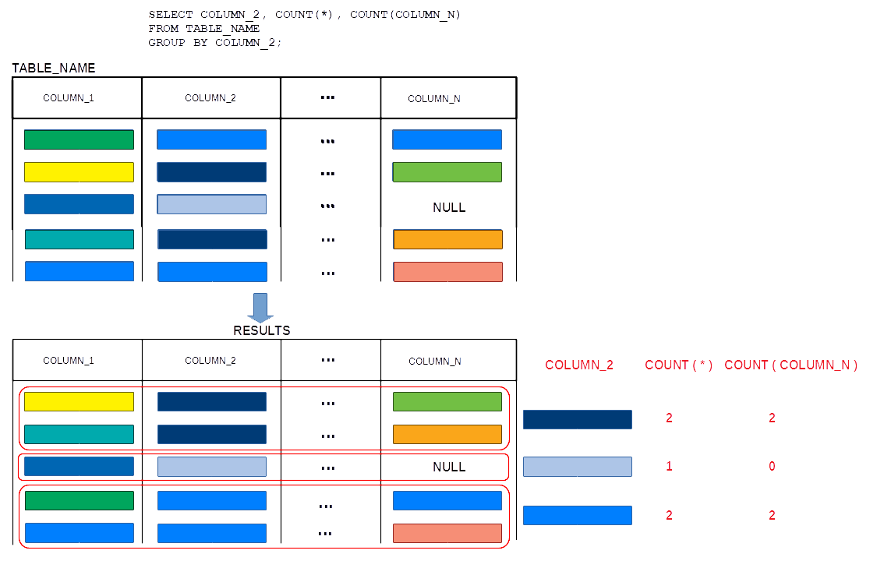
Grouping
Aggregation function can be applied to an empty group of values
25
Notes:
<!-- Neural, Brian, Male, British English. --><speak><break time="0.5s"/><prosody rate="90%">An interesting question is, what happens when an aggregation function is applied to a group of rows that have only NULLs, in an aggregated column.<break time="0.3s"/>For example, in the present slide we group a relational table by: COLUMN 2, and we apply aggregation function: COUNT, to COLUMN N.<break time="0.3s"/>A group of rows that have light blue colour in COLUMN 2 is associated with NULL in COLUMN N.<break time="0.3s"/>If an aggregation function: COUNT, is applied to an empty group of values then it returns zero.<break time="0.3s"/>This is because counting of the values in an empty set always returns zero.<break time="0.3s"/>Please note, that COUNT function never returns NULL.<break time="0.3s"/>This is why, it makes no sense to apply a row function: IS NULL, to the results of COUNT function.<break time="0.3s"/>It is a very common mistake made by the inexperienced S Q L programmers.<break time="0.5s"/></prosody></speak>
Systems Analysis
25

Slide 26
Grouping
Find the names of all departments that offer at least one course, do not list the duplicated name sof departments
SELECT DISTINCT offered_by
FROM COURSE;
SELECT offered_by
FROM COURSE
GROUP BY offered_by;
GROUP BY clause sorts a relational table over the columns included in GROUP BY list and creates the groups of rows with the identical values in the columns in GROUP BY list
In the example above a table COURSE is sorted over the values in a column offered_by
The groups of rows with the identical values in a column offered_by are created
Finally, the values of an attribute offered_by are selected, one value from each group
26
Notes:
<!-- Neural, Brian, Male, British English. --><speak><break time="0.5s"/><prosody rate="90%">Assume, that we would like to "find the names of all departments, that offer at least one course" and we would like to eliminate the duplicates from the results.<break time="0.3s"/>The names of departments, that offer at least one course are located in a relational table: COURSE, in a column: offered by.<break time="0.3s"/>If a department offers more than one course then, its name is listed in a column: offered by, more than one time.<break time="0.3s"/>To eliminate the duplicates from the results of SELECT statement, we can use a keyword: DISTINCT, in front of a list of columns in a SELECT clause.<break time="0.3s"/>The same result can be obtained through application of a GROUP BY clause with a name of column: offered by.<break time="0.3s"/>A solution that uses a GROUP BY clause returns a correct result, however, a complexity of its implementation is higher than in a statement with a DISTINCT clause.<break time="0.3s"/>Therefore, it is not recommended to use a GROUP BY clause, to eliminate the duplicates.<break time="0.3s"/>GROUP BY clause, sorts a relational table over the attributes included in GROUP BY list, and it creates the groups of rows with the identical values of the attributes in a GROUP BY list. <break time="0.3s"/>The second SELECT statement in the present slide sorts the rows in a table: COURSE, over the values of in a column: offered by.<break time="0.3s"/>Then, the groups of rows with the identical values of an attribute: offered by, are created.<break time="0.3s"/>Finally, the values of an attribute: offered by, are selected, one value from each group.<break time="0.3s"/>Still, it is faster to use a DISTINCT clause, to eliminate the duplicates.<break time="0.5s"/></prosody></speak>
Systems Analysis
26

Slide 27
Grouping
Grouping allows for application of group functions to each group created by GROUP BY clause
Find the names of all departments together with the total number of all courses offered by each department
SELECT offered_by, COUNT(*)
FROM COURSE
GROUP BY offered_by;
Before sorting
+---------+------------+---------+------------------+
| cnum | title | credits | offered_by |
+---------+------------+---------+------------------+
| CSCI111 | C++ | 6 | Computer Science |
| PHYS312 | Relativity | 6 | Physics |
| MATH111 | Calculus | 12 | Mathematics |
| CSCI235 | Databases | 6 | Computer Science |
| MECH111 | Mechanics | 12 | Physics |
+---------+------------+---------+------------------+
27
Notes:
<!-- Neural, Brian, Male, British English. --><speak><break time="0.5s"/><prosody rate="90%">Grouping of rows with a GROUP BY clause allows for the applications of group functions, to each one of the groups.<break time="0.3s"/>Assume, that we would like to "find the names of all departments together with the total number of all courses offered by each department".<break time="0.3s"/>Assume, that we do not need to list the names of departments, that offer no courses.<break time="0.3s"/>It is explained later, how to append the departments, that offer no courses into the results of the query.<break time="0.3s"/>If a department offers one or more courses then, its name occurs in a column: offered by, one more time.<break time="0.3s"/>We group the rows by the names of departments listed in a column: offered by.<break time="0.3s"/>Each group contains information about all courses offered by a single department.<break time="0.3s"/>Grouping can be implemented by sorting of a relational table: COURSE, over a column: offered by, or by hashing the values in a column offered by.<break time="0.3s"/>Hashing will group the rows with the same names of departments in the same hash buckets.<break time="0.3s"/>The sample contents of a relational table: COURSE, is visualized at the bottom of the present slide.<break time="0.3s"/>A manual grouping of data in a relational table: COURSE, and counting the total number of rows in each group provide the results where, Computer Science department offers 2 courses, Physics department offers 2 courses and Mathematics department offers only one course.<break time="0.3s"/>Now, the relational table: COURSE, is sorted and the outcomes are demonstrated in the next slide.<break time="0.5s"/></prosody></speak>
Systems Analysis
27

Slide 28
Grouping
Grouping allows for application of group functions to each group created by GROUP BY clause
Find the names of all departments together with the total number of all courses offered by each department
SELECT offered_by, COUNT(*)
FROM COURSE
GROUP BY offered_by;
After grouping by offered_by
+---------+------------+---------+------------------+
| cnum | title | credits | offered_by |
+---------+------------+---------+------------------+
| CSCI111 | C++ | 6 | Computer Science |
| CSCI235 | Databases | 6 | Computer Science |
| MATH111 | Calculus | 12 | Mathematics |
| MECH111 | Mechanics | 12 | Physics |
| PHYS312 | Relativity | 6 | Physics |
+---------+------------+---------+------------------+
28
Notes:
<!-- Neural, Brian, Male, British English. --><speak><break time="0.5s"/><prosody rate="90%">A sorted relational table: COURSE, allows for identification of the groups of rows with the same values in a column: offered by.<break time="0.3s"/>Then, the group functions can be applied to each group created by GROUP BY clause.<break time="0.3s"/>In the present example, we plan to count the total number of rows in each group.<break time="0.3s"/>To do so, we append a group function: COUNT, to a list of columns in a SELECT clause, and we use an argument: star, to count the complete rows in each group.<break time="0.3s"/>A grouped relational table: COURSE, with information about the courses and about the departments that offer the courses is visualized at the bottom of the present slide.<break time="0.3s"/>In the next slide, we apply a group function: COUNT, to each group.<break time="0.5s"/></prosody></speak>
Systems Analysis
28

Slide 29
Grouping
Grouping allows for application of group functions to each group created by GROUP BY clause
Find the names of all departments together with the total number of all courses offered by each department
SELECT offered_by, COUNT(*)
FROM COURSE
GROUP BY offered_by;
After counting rows in each group
+------------------+----------+
| offered_by | count(*) |
+------------------+----------+
| Computer Science | 2 |
| Mathematics | 1 |
| Physics | 2 |
+------------------+----------+
29
Notes:
<!-- Neural, Brian, Male, British English. --><speak><break time="0.5s"/><prosody rate="90%">Grouping of the rows in a relational table, allows for application of the group functions, to each group created by a GROUP BY clause.<break time="0.3s"/>A SELECT statement, that finds the names of all departments, together with the total number of all courses offered by each department, returns a relational table, that consists of two columns: offered by, and count star.<break time="0.3s"/>The first column contains the names of departments, one from each group, associated with the results from counting of the total number of rows in each group.<break time="0.3s"/>The results of SELECT statement, are visualized at the bottom of the present slide.<break time="0.5s"/></prosody></speak>
Systems Analysis
29

Slide 30
Grouping
Find the total number of courses per each value of credit points
SELECT credits, COUNT(*)
FROM COURSE
GROUP BY credits;
Find the total number of credit points available for the course offered by each department
SELECT offered_by, SUM(credits)
FROM COURSE
GROUP BY offered_by;
Find the largest number of courses offered by any department
SELECT MAX(total)
FROM (SELECT COUNT(*) total
FROM COURSE
GROUP BY offered_by) T;
30
Notes:
<!-- Neural, Brian, Male, British English. --><speak><break time="0.5s"/><prosody rate="90%">Now, we consider few more examples of grouping and application of group functions like: COUNT, SUM, and MAX.<break time="0.3s"/>The first query in the present slide, finds the total number of courses per each value of credits.<break time="0.3s"/>To implement such query, we have to use a relational table: COURSE, because the table contains information about the credit points granted for the successful completions of the courses.<break time="0.3s"/>Next, we find, that grouping must be performed over the values in a column: credits.<break time="0.3s"/>It also indicates, that we must use a column: credits, in a SELECT clause.<break time="0.3s"/>To count the total number of rows in each group, we append a group function: COUNT star, to a SELECT clause.<break time="0.3s"/>In the second example, we would like to "find the total number of credit points available for the course offered by each department".<break time="0.3s"/>If we assume, that we are interested only in the departments that offer at least one course, then we can get all required information from a relational table: COURSE.<break time="0.3s"/>To find the total number of credit points per each department, we have to group the rows in a relational table: COURSE, by the values in a column: offered by.<break time="0.3s"/>It is the same idea as in the earlier example, where we counted the total number of courses per department.<break time="0.3s"/>This time, we do not count the courses.<break time="0.3s"/>Instead, we perform summation of the values in a column: credits, for each department.<break time="0.3s"/>This is why, we use a group function: SUM, with an argument: credits.<break time="0.3s"/>A group function: SUM, returns the results of summation of all values in a column: credits.<break time="0.3s"/>In the last example, we would like to find the largest number of courses offered by any department.<break time="0.3s"/>To implement such query as a SELECT statement, we decompose the query into two sub queries.<break time="0.3s"/>The first one finds the total number of courses offered by each department.<break time="0.3s"/>We have already implemented such query in the previous slide.<break time="0.3s"/>Now, we assume, that we have a relational table: T that consists of a single column: total, created by grouping of the rows in a relational table: COURSE, by the values in a column: offered by and counting the total number of rows in each group.<break time="0.3s"/>The results of counting are stored in a column: total, in a relational table T.<break time="0.3s"/>Then, a simple application of MAX function to a column: total, provides the largest number of courses offered by any department.<break time="0.3s"/>Note, that SELECT statement finding the total number of courses per department, implements inline view: T.<break time="0.3s"/>To be able to refer to a column in inline view: T, we add an alias name: total, to COUNT star function in SELECT clause.<break time="0.3s"/>Note, a blank, and not comma, between SELECT COUNT star and a name of a column: total.<break time="0.3s"/>A blank indicates an alias name for the results of counting.<break time="0.3s"/>A comma between count star and total, would be syntactically incorrect, because a relational table: COURSE, does not have a column: total, and grouping is performed by a column: offered by.<break time="0.5s"/></prosody></speak>
Systems Analysis
30

Slide 31
Outline
Queries with simple conditions
Queries with Boolean expressions
Set algebra queries
Sorting
Queries about the lack of values (NULLs)
Grouping
Grouping with selections
31
Notes:
<!-- Neural, Brian, Male, British English. --><speak><break time="0.5s"/><prosody rate="90%">Grouping with selections.<break time="0.5s"/></prosody></speak>
Systems Analysis
31

Slide 32
Grouping with selections
Find the names of all departments that offer more than 1 course
SELECT offered_by, COUNT(*)
FROM COURSE
GROUP BY offered_by;
+------------------+----------+
| offered_by | count(*) |
+------------------+----------+
| Computer Science | 2 |
| Mathematics | 1 |
| Physics | 2 |
+------------------+----------+
32
Notes:
<!-- Neural, Brian, Male, British English. --><speak><break time="0.5s"/><prosody rate="90%">We start from a query, that "finds the names of departments together with the total number of courses offered by each department".<break time="0.3s"/>To implement such query as a SELECT statement, we access a relational table: COURSE, and we group the rows in the relational table by the values in a column: offered by.<break time="0.3s"/>A SELECT statement, that implements the query is listed at the top of the present slide.<break time="0.3s"/>A sample relational table returned from processing of the SELECT statement, is visualized at the bottom of the present slide.<break time="0.3s"/>Now, assume, that we are interested only in the departments, that offer more than one course.<break time="0.3s"/>How do we express a selection condition on the results of grouping and counting ?<break time="0.5s"/></prosody></speak>
Systems Analysis
32

Slide 33
Grouping with selections
Find the names of all departments that offer more than 1 course
SELECT offered_by, count(*)
FROM COURSE
GROUP BY offered_by
HAVING count(*) > 1;
+------------------+----------+
| offered_by | count(*) |
+------------------+----------+
| Computer Science | 2 |
| Physics | 2 |
+------------------+----------+
33
Notes:
<!-- Neural, Brian, Male, British English. --><speak><break time="0.5s"/><prosody rate="90%">To express a selection condition on the results of grouping and counting, we use a HAVING clause.<break time="0.3s"/>For example, if we would like to find the names of departments, that offer more than one course, then we add to the SELECT statement a HAVING clause, with a condition count star greater than 1.<break time="0.3s"/>A HAVING clause compares the results of counting in each group, with a constant.<break time="0.3s"/>A very common mistake is to use a WHERE clause, instead of a HAVING clause.<break time="0.3s"/>A WHERE clause expresses a condition evaluated on the values from a single row.<break time="0.3s"/>A HAVING clause expresses a condition evaluated on the values from an entire group of rows.<break time="0.3s"/>This is why, the group functions cannot be use in WHERE clauses.<break time="0.3s"/>A SELECT statement that implements a query: "find the names of departments, that offer more than one course", is given at the top of the present slide and a sample answer is visualized below.<break time="0.5s"/></prosody></speak>
Systems Analysis
33

Slide 34
References
C. Coronel, S. Morris, A. Basta, M. Zgola, Data Management and Security, Chapter 5 Introduction to Structured Query Language, Cengage Compose eBook, 2018, eBook: Data Management and Security, 1st Edition
T. Connoly, C. Begg, Database Systems, A Practical Approach to Design, Implementation, and Management, Chapters 6.3.1 - 6.3.4 Data Manipulation, Pearson Education Ltd, 2015
D. Darmawikarta, SQL for MySQL A Beginner’s Tutorial, Chapters 2 - 5, Brainy Software Inc. First Edition: June 2014
How to ... ? Cookbook, How to implement queries in SQL, Recipe 5.1 How to implement SELECT statements with simple Boolean expressions ?
34
Notes:
<!-- Neural, Brian, Male, British English. -->
<speak>
<break time="0.5s"/>
<prosody rate="90%">
References
<break time="0.5s"/>
</prosody>
</speak>
Systems Analysis
34

